Slide 1










Empowering Growth Through Quality Education
& Global Partnerships

Slide 2








ABOUT US
Established in 2009
Nepal’s first organisation quality-assured by Qualifications Scotland
Multiple qualifications
Multi-country operations
Multi-international articulations

Slide 3




Mission & Vision
Mission
Advance careers through learning with global quality skills
Vision
Empower learners with international recognition

Slide 4

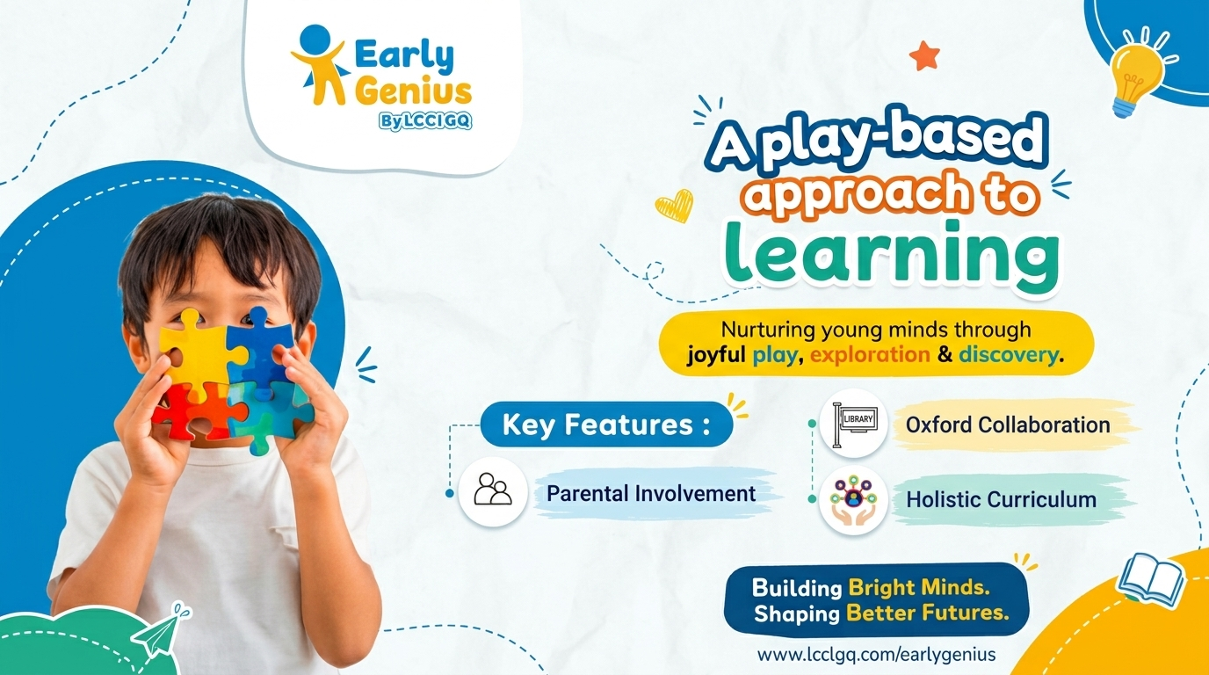


Our Verticals

Slide 5
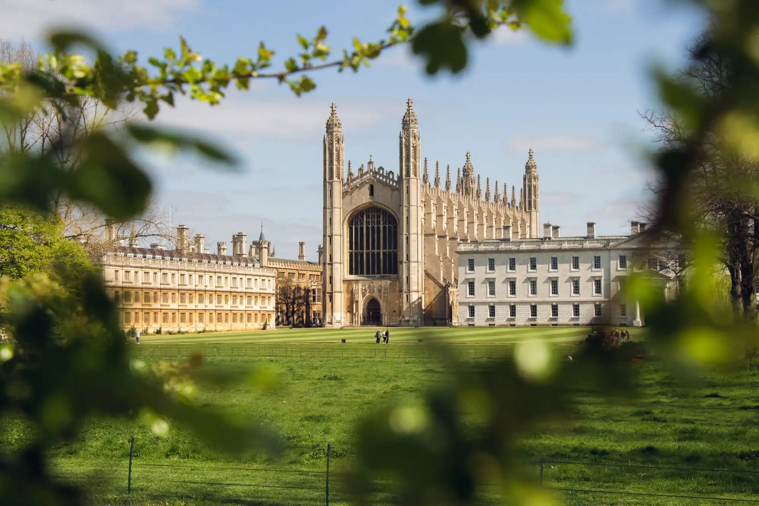




Our Verticals

Slide 6




Our Verticals

Slide 7




Our Verticals
Soft Skills Training
LCCI Books

Slide 8
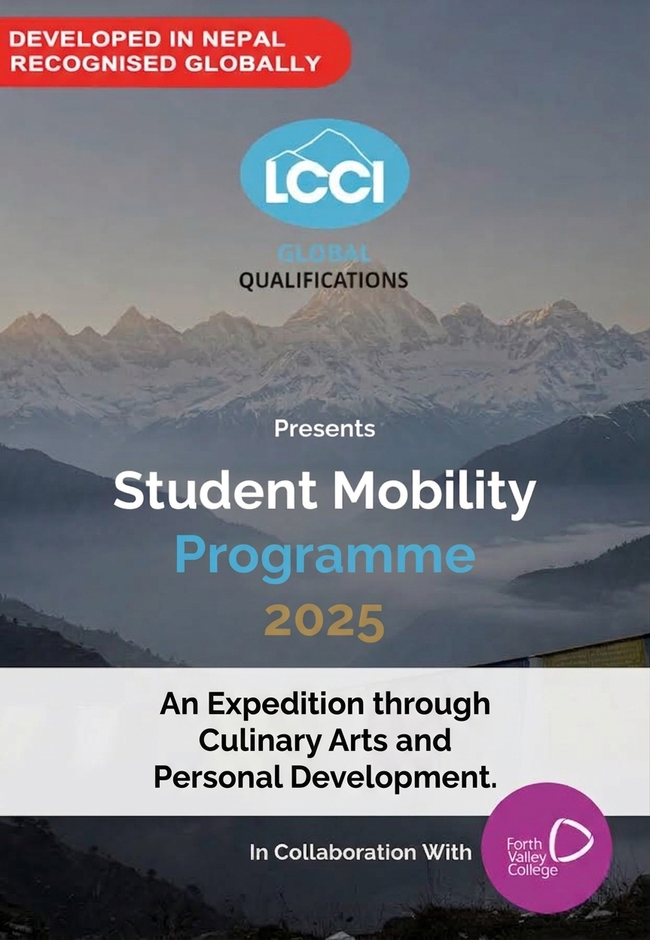
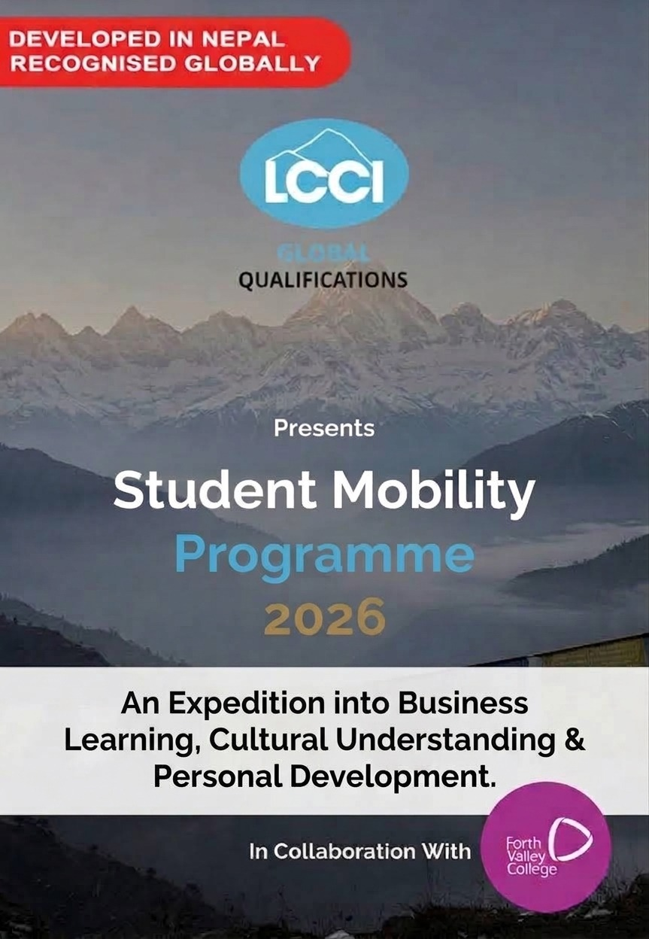
Our Verticals
Student Mobility Programme | LCCI Global Qualifications

Slide 9



